Slide 1


OPEN SOURCE PLASTIC
RECYCLING MACHINE
Mardi 5 Octobre
Notes:
WILLIAM

Slide 2
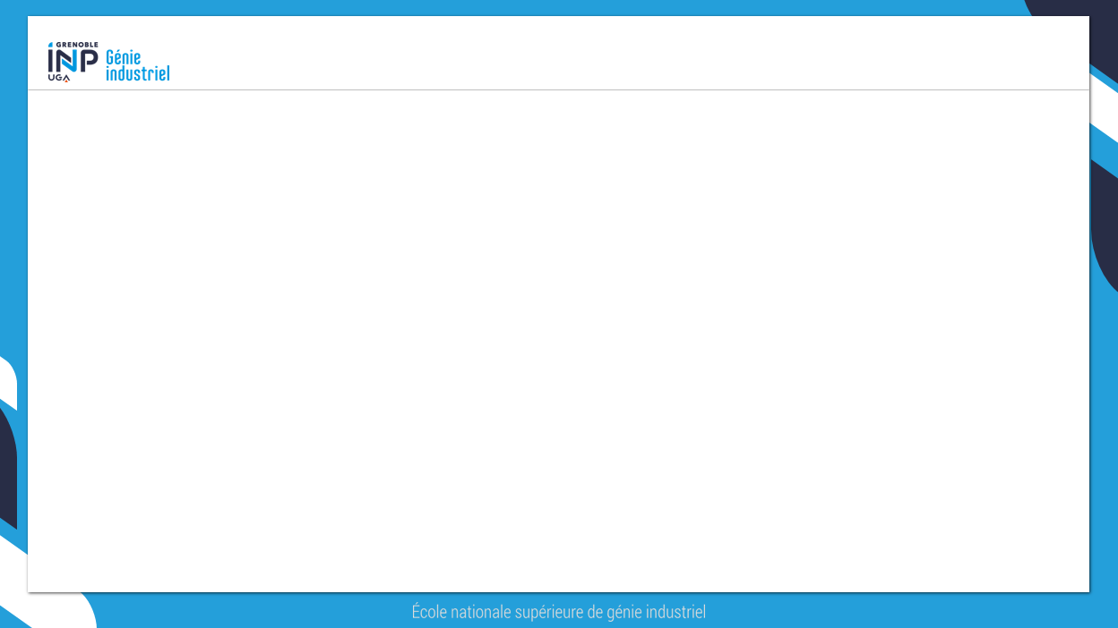



Table of contents
1 - Presentation of the client and his expectations
2 - Presentation of the physiotherapist and his expectations
3 - Organization
4 - Systems engineering of the shredder
5 - CAD and first progress
Notes:
WILLIAM

Slide 3

Overview of the project
The client
Germain
LEMASSON
FabMSTIC
The Physiotherapist
Manuel
FRANÇOIS
Us :
Louis GASTON Maxime CLAVEL
Tom BIANCIOTTO William LEGARDEUR
Nsongurua WILLIE Margaux LENNE
Guillaume MARIN
- Gave us his prototype of the shredder
- Gave us his prototype of the oven/compressor
Sarah LIEDOT
Show us her work done on recycling 3D printing machine
Notes:
Margaux

Slide 4
Table of contents
1 - Presentation of the client and his expectations
Notes:
Margaux

Slide 5


THE CLIENT
22/09/2021 : first meeting
Discovery of the fabmstic
Presentation of the machines used for plastic recycling
His expectations
Germain
LEMASSON
FabManager FabMSTIC
Ingénieur de Recherche LIG
740 rue de la Piscine, 38400 Saint-Martin-d’Hères
Notes:
Margaux

Slide 6
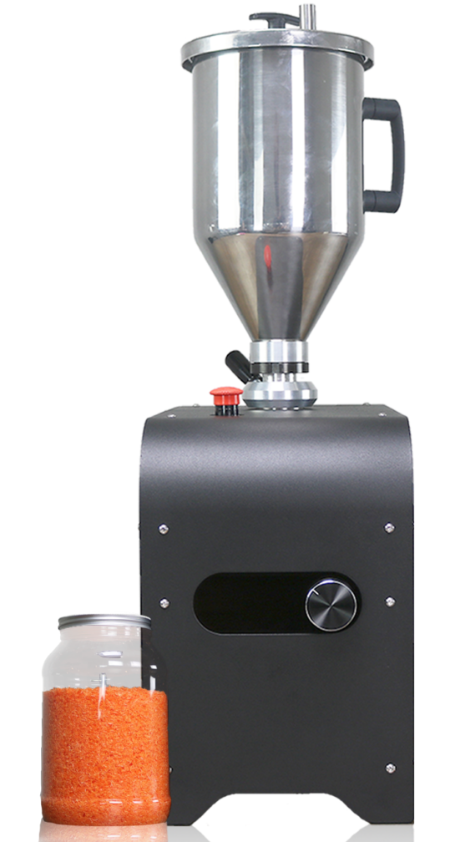
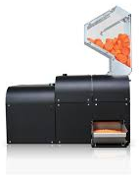
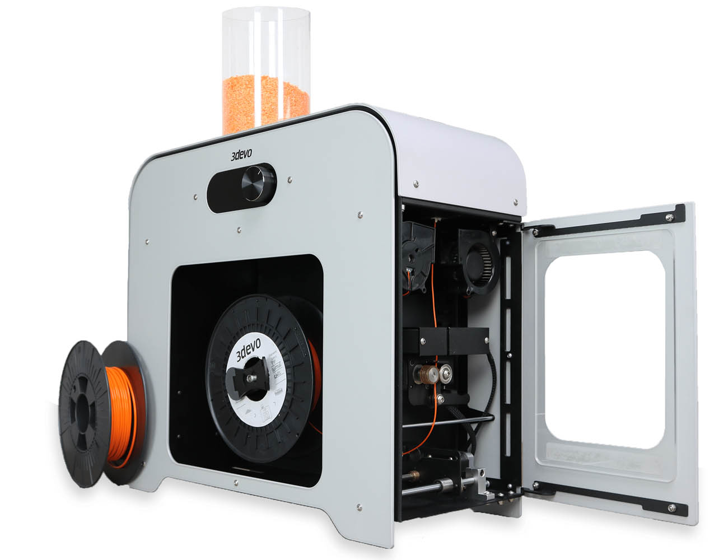
THE MACHINES IN THE FABMSTIC
The
shredder
The dryer
The
filament maker
Notes:
Margaux

Slide 7
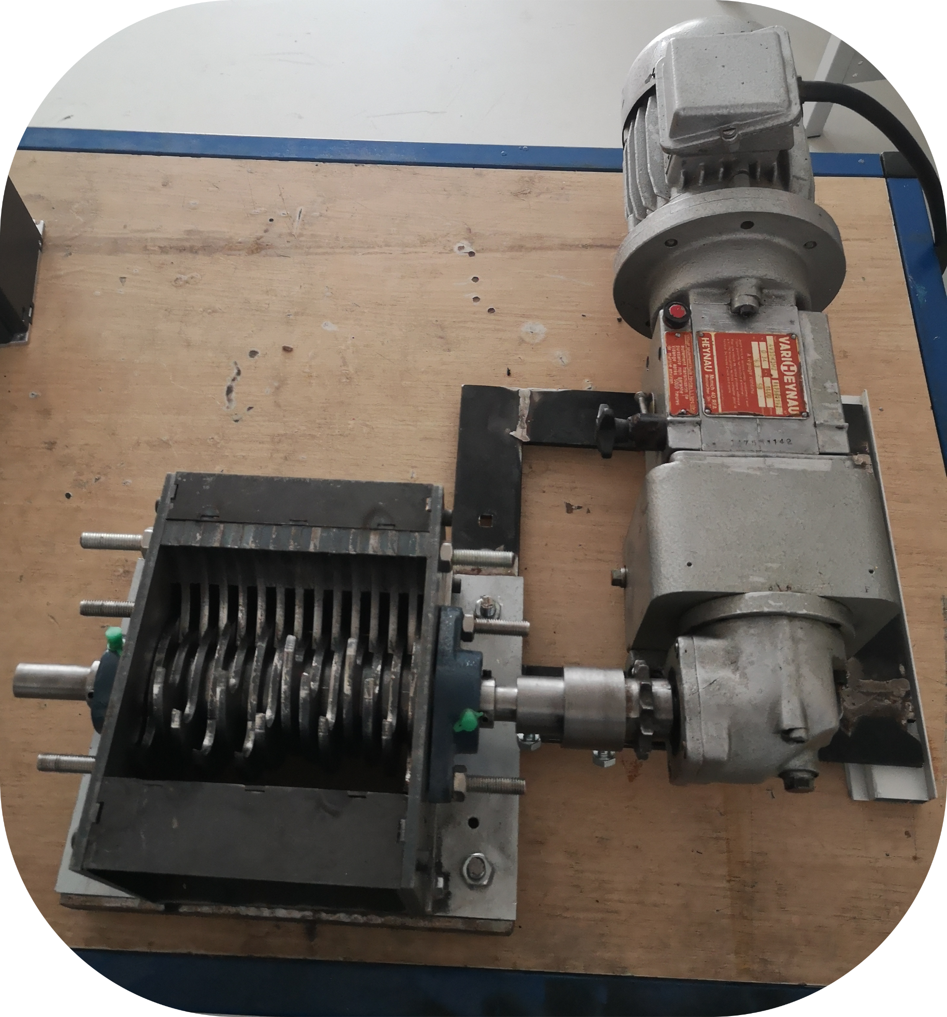
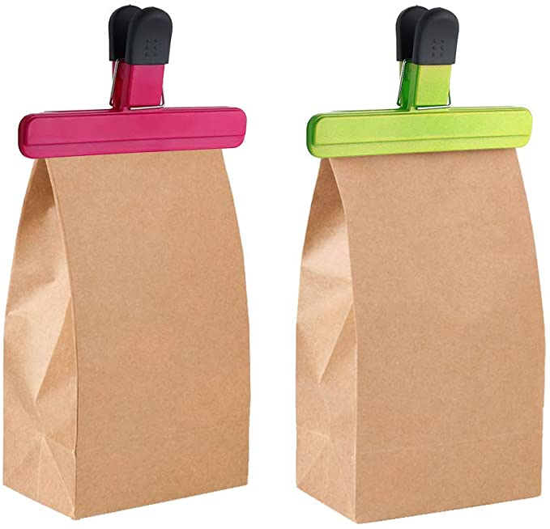
Mr LEMASSON EXPECTATIONS
Plastic
- ABS
- PLA
From plastic collection of the Grenoble Alpes University Community
ABS
PLA
Plastic chips in bags
Large pieces to be shredded
given for the collect
Our low tech shredder :
Big plastic chips
Transport
Notes:
Margaux

Slide 8
Table of contents
1 - Presentation of the client and his expectations
2 - Presentation of the physiotherapist and his expectations
Notes:
WILLIE

Slide 9


The Physiotherapist
28/09/2021 : first meeting
Discovery of his lab
Demonstration of his practice of thermoplastique on Tom
His expectations
Address of his lab
57 Rue DE MORTILLET 38000 Grenoble
Manuel
FRANÇOIS
Physiotherapist
Orthotist
Also working in the SOS - Hand Surgery Department of the CHUGA
Notes:
WILLIE

Slide 10
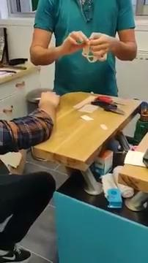
DEMONSTRATION ON TOM
Notes:
WILLIE

Slide 11
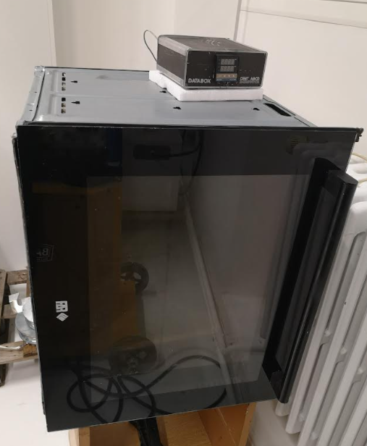
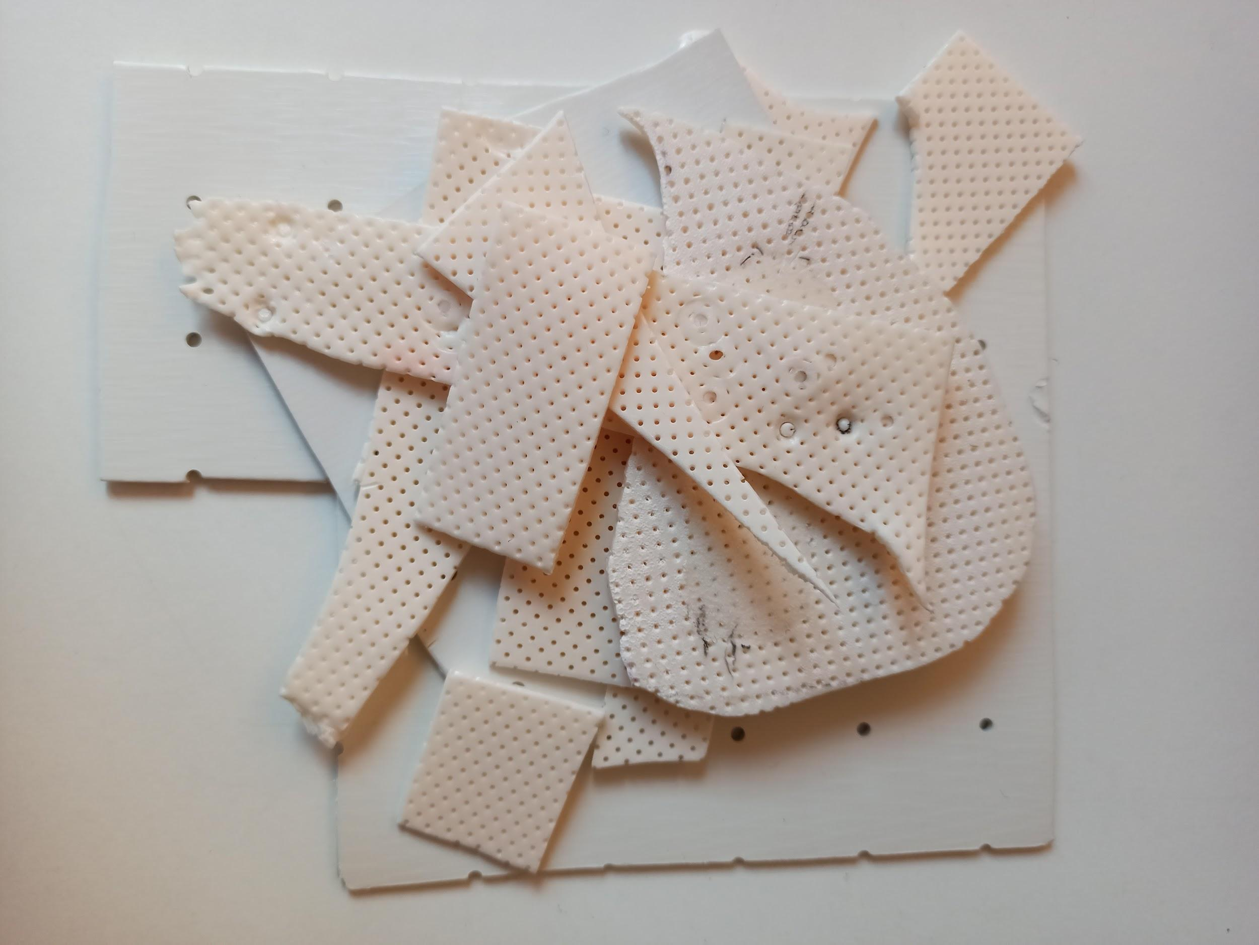

PHYSIOTHERAPIST’S EXPECTATIONS
Photo TOM
STEP 1
STEP 2
Leftover and unusable pieces of plastic given by the physiotherapist
Our job :
To shred these pieces of plastic
Our low tech press : to make new plastic plate thanks to 2 heating plates.
Making splints from recycled plastic plates
Desired thickness :
1,6 mm
2,5 mm
3,2 mm
STEP 4
Make holes if possible
STEP 3
Manuel FRANÇOIS
Notes:
WILLIE

Slide 12
Table of contents
1 - Presentation of the client and his expectations
2 - Presentation of the physiotherapist and his expectations
3 - Organisation
Notes:
LOUIS

Slide 13
GANTT
https://docs.google.com/spreadsheets/d/1V2rL0MdPak73RSWx6rxGbo7XgAtCdY4lU-Oaq7VOChI/edit#gid=0
GANTT S1 |  | Durées | S38 | S39 | S40 | S41 | S42 | S43 | S44
 |  |  | 20/09-26/09 | 27/09-03/10 | 04/10-10/10 | 11/10-17/10 | 18/10-24/10 | 25/10-31/10 | 01/11-07/11
Infos partiels |  | NA |  |  |  |  |  |  | T O U S S A I N T
Infos livrables
A | Read the given documents about plastic and machines | 2
B | Meet the client, Germain LEMASSON | 1
C | Meet the physiotherapist | 1
D | Specifications and architectures | 2
E | Make the requirements chart (one group) | 1
F | To make the engine works | 3
G | Organise the collect of the plastic with the RAFU network | 3
H | To study the engine characteristics and see if we have to change it + Find a new one if necessary | 3
I | To securise the shredder with a hopper and a cover | 3
J | To install emergency button, external potentiometer and forward/backward switch | 2
Notes:
LOUIS

Slide 14
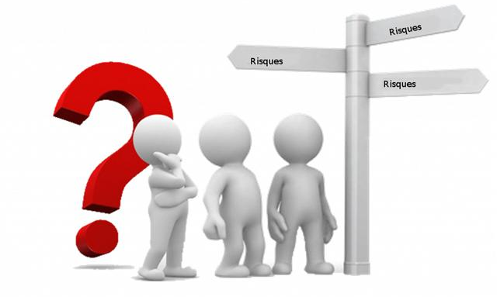
RISK ANALYSIS
https://docs.google.com/spreadsheets/d/1wn31kHZWb68TZ7vg97NMGhf_2zeIdimLPqPW3YUUcGw/edit#gid=0
Notes:
LOUIS

Slide 15
Table of contents
1 - Presentation of the client and his expectations
2 - Presentation of the physiotherapist and his expectations
3 - Organisation
4 - Systems engineering of the shredder
Notes:
MAXIME

Slide 16
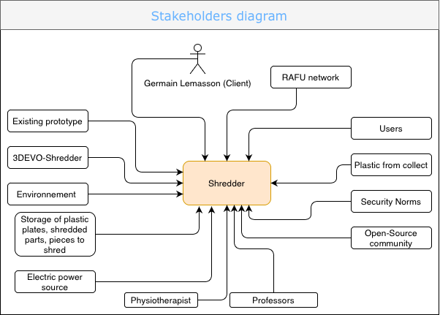
Stakeholders
Notes:
MAXIME

Slide 17
Table of contents
1 - Presentation of the client and his expectations
2 - Presentation of the physiotherapist and his expectations
3 - Organisation
4 - Systems engineering of the shredder
5 - CAD and first progress
Notes:
TOM

Slide 18
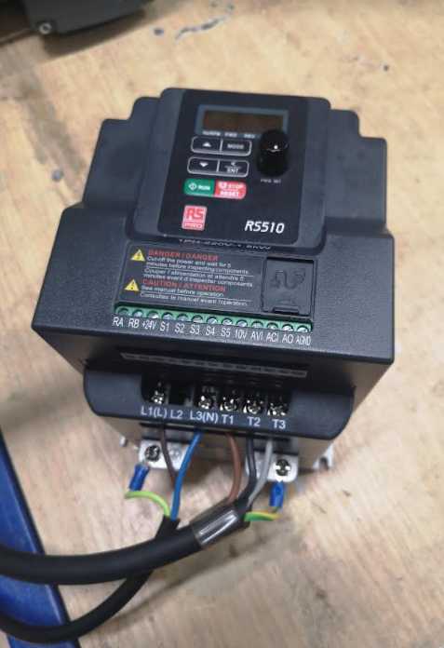
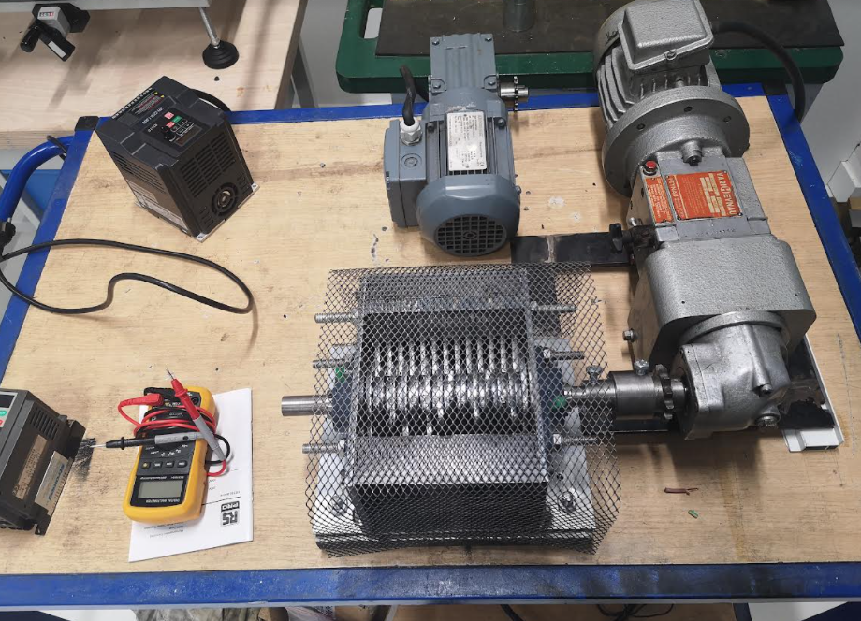
First progress
Problem : The engine of the shredder which requires a three-phase plug
Solution : To use a converter
To do from now on : Gantt task H → To study the engine characteristics and see if we have to change it
Notes:
TOM

Slide 19
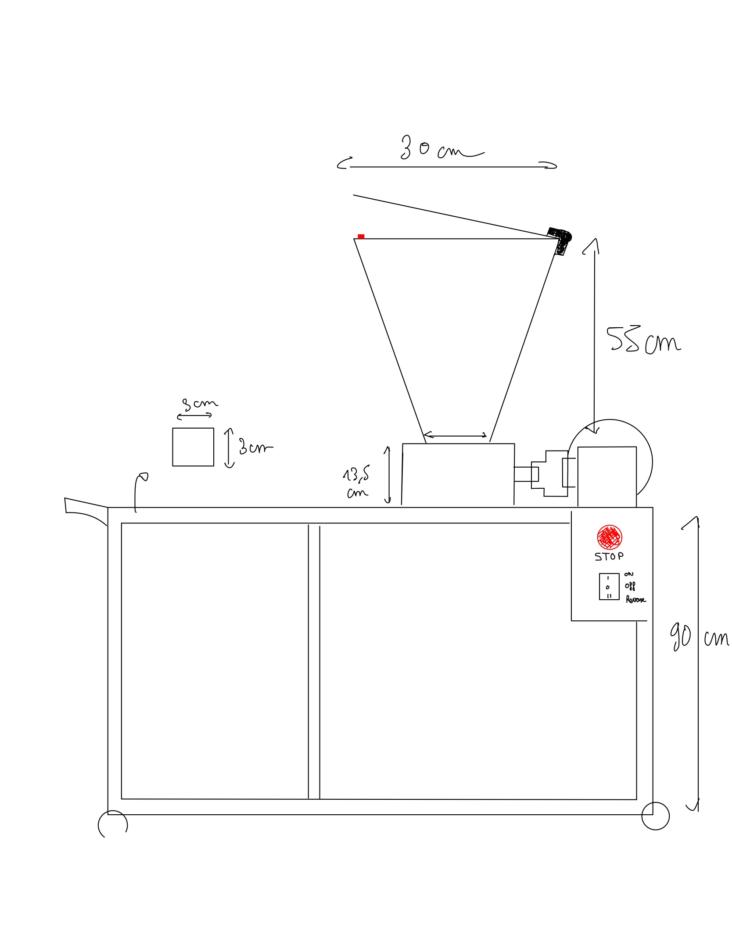
First progress
Notes:
TOM

Slide 20
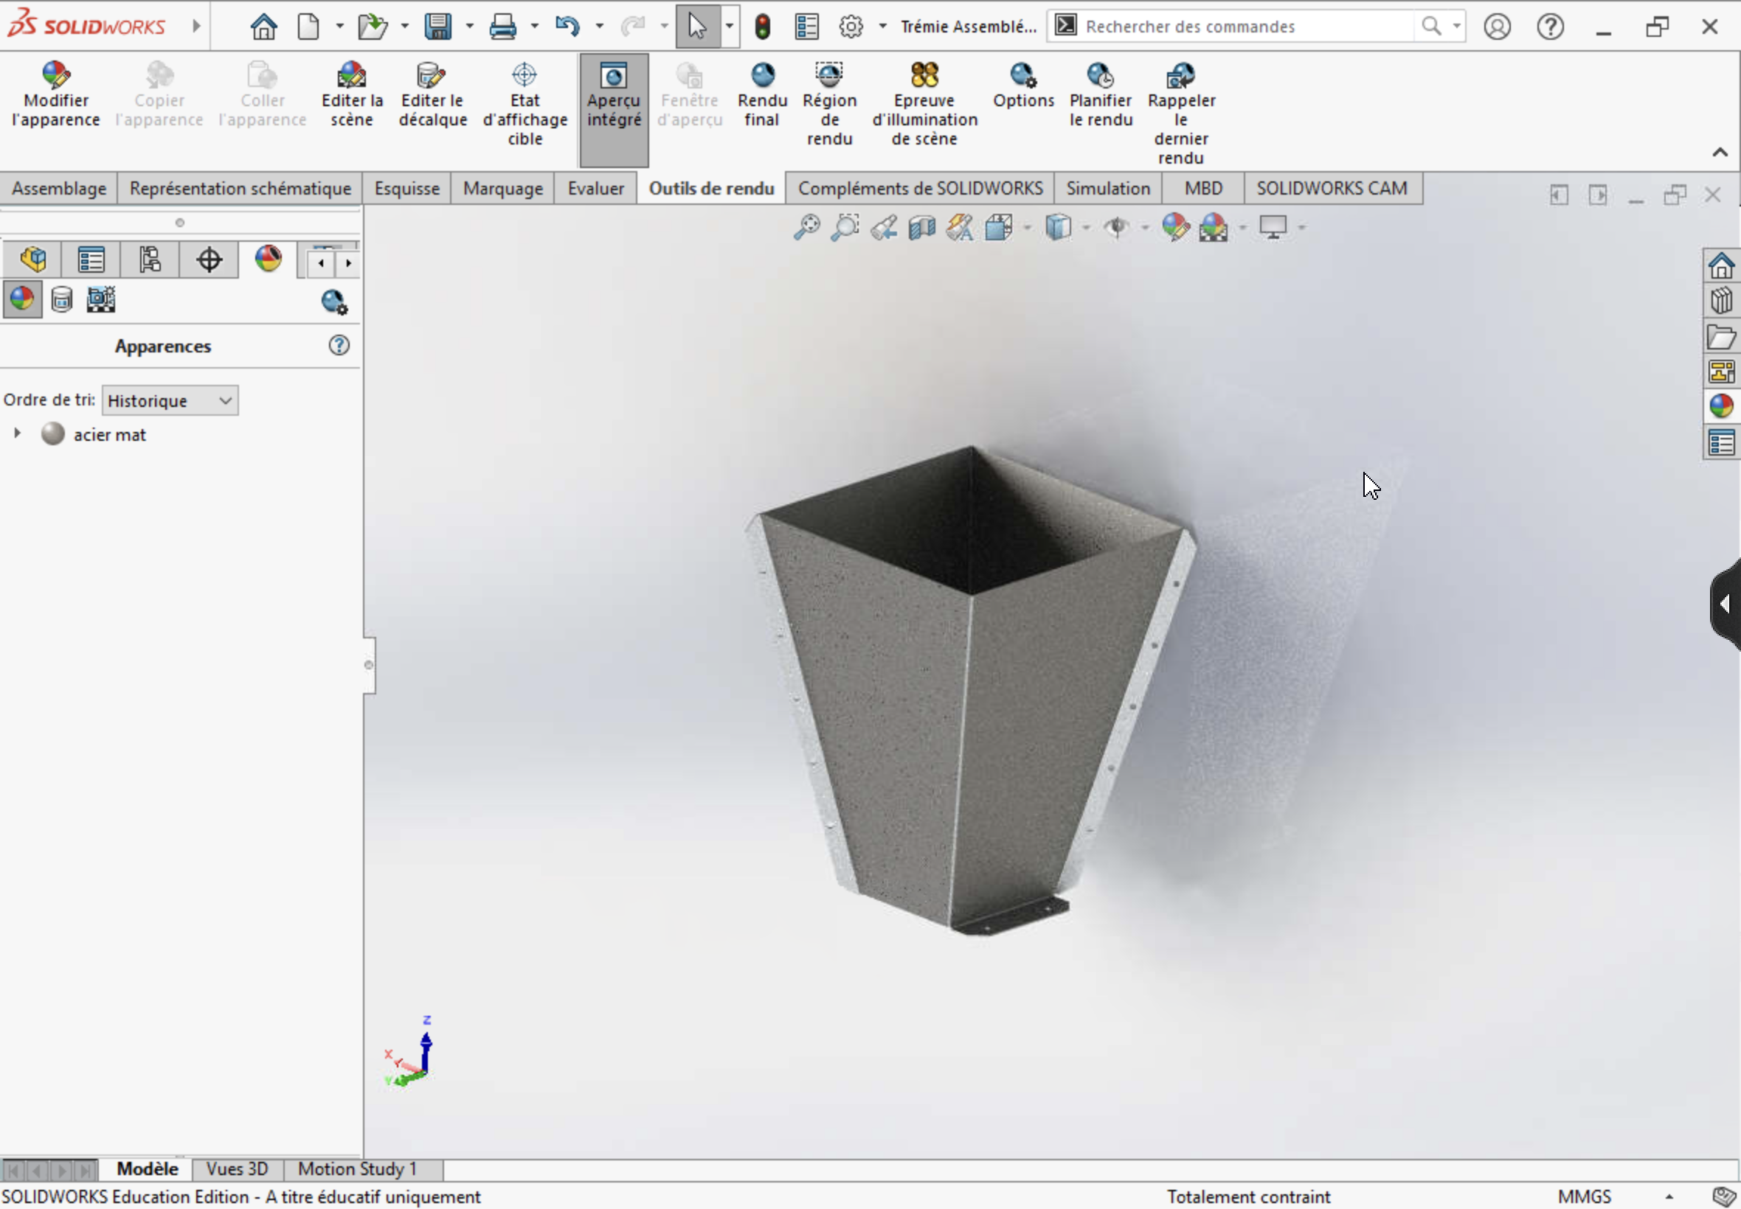
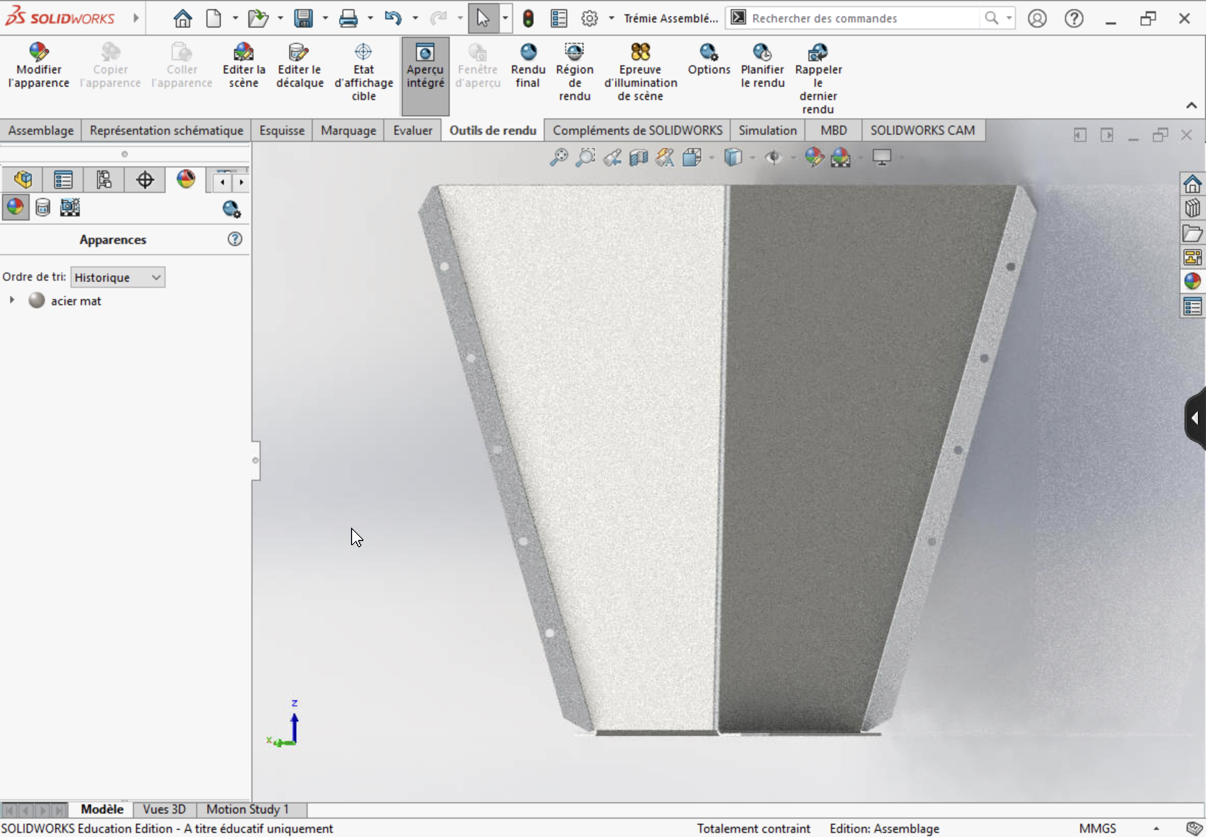
CAD - THE HOPPER
Gantt task I : To securise the shredder with a hopper and a cover
CAD drawing of the hopper
(The hopper will be cut at the E3 school on monday 18th tanks to Alain)
Notes:
William

Slide 21
Interrogations
Is it realistic to plan the design of the plastic press taking into account the work we have to do for the shredder and the organisation of the plastic collection ?
How to manage System engineering for this project - shall we talk about the whole project (shredder + compressor) or focus on each element ? or both ?
How to organize the transportation between the big ships made in GI and Germain LEMASSON ? Software for the customer to enter his chips requirements (type and quantity) and for the information to reach GI ?
Who can be contacted in the school to request for bins to collect or to store our chips of plastic ?
Notes:
Someone else

Slide 22
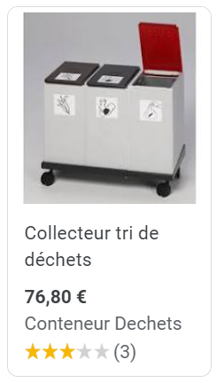
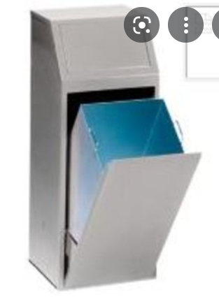
????
Notes:
GANTT, steps, tasks

Slide 23


ventilation and air filtration system
led
on/off button
emergency stop
+ resistance
+ thermostat
2 heating plates
mould
actuator
Figure 9 : Schematic of the final
prototype of the hot press

